Slide 1
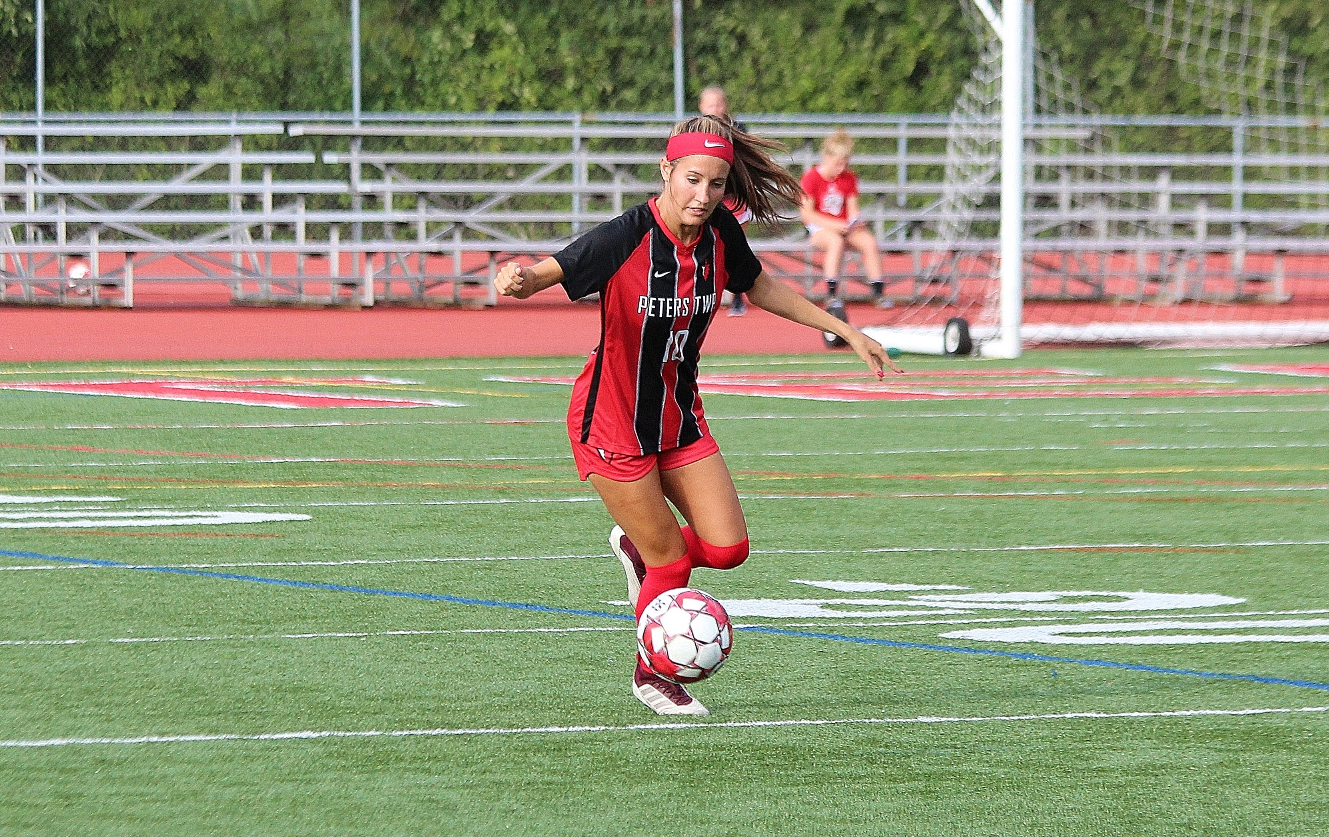
Thanks for the memories!
What a great run
LOVE you!
Mom, DAD, & ALEC
RACHEL RABER #10

